Slide 1

Office Supplies
Statewide Contract Webinar
Notes:
Good afternoon everyone. My name is Carl Hall. I am an Associate Category Manager in the Strategic Sourcing Division of State Purchasing. Thank you for joining today’s webinar for the Statewide Contract for Office Supplies. Please note that all participants will be muted during the presentation. During the question and answer period, you will please submit your questions via the questions panel. We have well over 400 participants from across the State. We will do our best to respond to all questions. However, if we are unable to field them all, we will post responses to the remaining questions on the DOAS website. Additionally, this webinar is being recorded and will be posted, in its entirety, on the DOAS website, for your future reference.

Slide 2
Your Presenter
Title: Associate Category Manager
Experience: 20+ years of Procurement/Contracting Experience
Contact Information: carl.hall@doas.ga.gov
404-657-4254
Carl A. Hall

Slide 3
AGENDA
Contract Overview - Carl A. Hall, DOAS
Team Georgia Marketplace Ordering – Ed Macey and Marcus Britton, DOAS
Paper & Toner Ordering - Lamar Huff, Staples
General Office Supplies – Terone Harris and Andy Braselton, OfficeMax
Closing

Slide 4

Purpose of this Webinar
The purpose of this webinar is to:
Explain the purpose of the Statewide Contract
Review the benefits of the Statewide Contract
Highlight specific details related to the Statewide Contract
List the steps you follow to find the Statewide Contract on the SPD website
Introduce the suppliers selected to provide products and service under this statewide contract
Discuss FAQs related to the Statewide Contract
Describe the procedures for obtaining more information about the Statewide Contract.
Statewide Contracts
Notes:
What is the purpose of this informational webinar? This session is designed to………,

Slide 5

Purpose
The purpose of the Statewide Contract for Office Supplies is to:
Provide a broad product range of Paper, Toner & General Office Supplies to State Agencies, Universities/Colleges and Municipal Users at the overall most competitive price & terms.
Statewide Contracts
Notes:
This contract can be best described as a “Preferred Convenience” contract. Your DOAS procurement team has worked extremely hard to conduct a solid competitive solicitation for this category which has resulted in very deep discounts on a market basket of approximately 900 Core Items, used most frequently throughout the State, as well as very deep % discounts off the catalog list price for thousands of additional Non-Core Items. If you consider the full Core market-basket, you will see the awesome leverage of State spend which served as the solid foundation for our negotiating such favorable pricing – pricing which would be very difficult to compete with independent of this contract.

Slide 6
Statewide Contract Details
About the Statewide Contract
What is the Contract Number?
99999-SPD0000065-001 (Paper/Toner)
99999-SPD0000065-002 (Gen. Office Supplies)
Is it a Renewal?
No
Does it Replace an Existing Contract?
Yes (99999-SPD-G20100809-001)
What is the Contract Term?
04/01/2012 – 03/31/2014
Implementation “Go-Live Date”
Estimated: June 18, 2012
Does it Allow the Use of the P-Card?
Yes
Who is the Person to Contact with Questions:
Dr. Carl A. Hall
Carl.hall@doas.ga.gov
404-657-4254
Notes:
[Title of the course]
23-Mar-15
Copyright © 2004-2005 NameOfTheOrganization. All rights reserved.
6
Again, resulting from a very competitive bidding environment, DOAS awarded statewide contracts to STAPLES for Paper and Toner Items, and to OfficeMax for General Office Supplies. Please note that the definition of General Office Supplies is, by default, “all other office supplies items that are either 1) Not Paper or Toner or 2) Products that are covered under another Statewide contract. Additionally, it is very important to note that each of these suppliers are contracted to provide only the AWARDED CATEGORY, under this contract: STAPLES (PAPER & TONER) and OFFICEMAX (GENERAL OFFICE SUPPLIES).
The projected “Go-Live” date for this new contract is 06/18/2012. We are working with both suppliers, towards this goal. We will keep you all posted regarding the Go-Live date, as we proceed.

Slide 7
Key Benefits
The Office Supplies Contract provides the following benefits:
Deep Discounts on approximately 900 Core and thousands of Non-Core Items
Next-Day Delivery & No Shipping Charges
Accepts P-Card
Offers Remanufactured & Original Equipment Manufacturer’s Toners
Custom State of Georgia Information Portal
Accepts Phone and Fax Orders
On-Line Ordering available on Team Georgia Marketplace and Supplier’s Customized Micro Site
Access to Retail Stores (Same Contracted Pricing)
Efficient returns & warranty process
Dedicated Account Management and Customer Service Team
Access to numerous environmentally friendly green-based product offerings
No Minimum Order Requirements
Notes:
While price was a very important consideration during the bidding event, it was not the only factor considered. Some of the other resulting Key Benefits of this contract include:

Slide 8
TEAM GEORGIA MARKETPLACE ORDERING PROCESS
MR. ED MACEY
MR. MARCUS BRITTON
Notes:
I would like to now introduce Mr. Ed Macey and Mr. Marcus Britton, of DOAS, who will provide you an overview of how to order office supply items, for those who are currently on Team Georgia Marketplace. Ed/Marcus

Slide 9
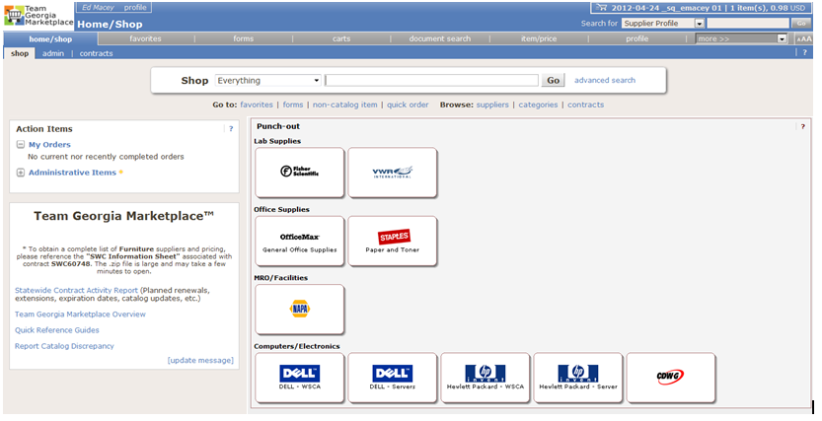
TEAM GEORGIA MARKETPLACE ORDERING

Slide 10
STAPLES CUSTOMER ACCOUNT MANAGEMENT HIGHLIGHTS
Mr. Lamar Huff
Senior Account Manager
Staples Business Advantage
Notes:
Thank you very much Ed & Marcus. For follow-up questions regarding Team Georgia Marketplace, you may contact our Procurement Helpdesk team at 404-657-6000. I would like to now introduce Mr. Lamar Huff, who is here representing STAPLES, our awarded supplier for Paper and Toner,

Slide 11
New Contract Highlights
Staples Advantage is excited to continue our partnership with the State of GA.
Seamless transition for State entities currently doing business with Staples Advantage.
Customers may place orders utilizing any of the following methods:
  SciQuest (Team GA Marketplace, GA 1st, UGA Mart, etc..)
  On-line via Staplesadvantage.com
  Phone orders may be placed by dialing 1-888-593-0146
  Purchase Orders may be faxed to 1-888-222-8618

Slide 12
New Contract Highlights
If you do not currently have an account with Staples Advantage you need to establish an account prior to ordering.
For more information about the State of GA program or to register for an account please visit the State of GA micro site. The web address for the micro-site is: http://staplesadvantage.com/stateofga/
  Please Note: Some information found on the micro site today makes reference to the existing contract details All information on the micro site will be updated by the contract conversion date.
Notes:
Lamar, be sure to explain the processing time required to activate a new account (2 -3 days). Explain the assigned account rep. system. The updated customer service rep list will be updated on Team Georgia Marketplace for future reference.

Slide 13
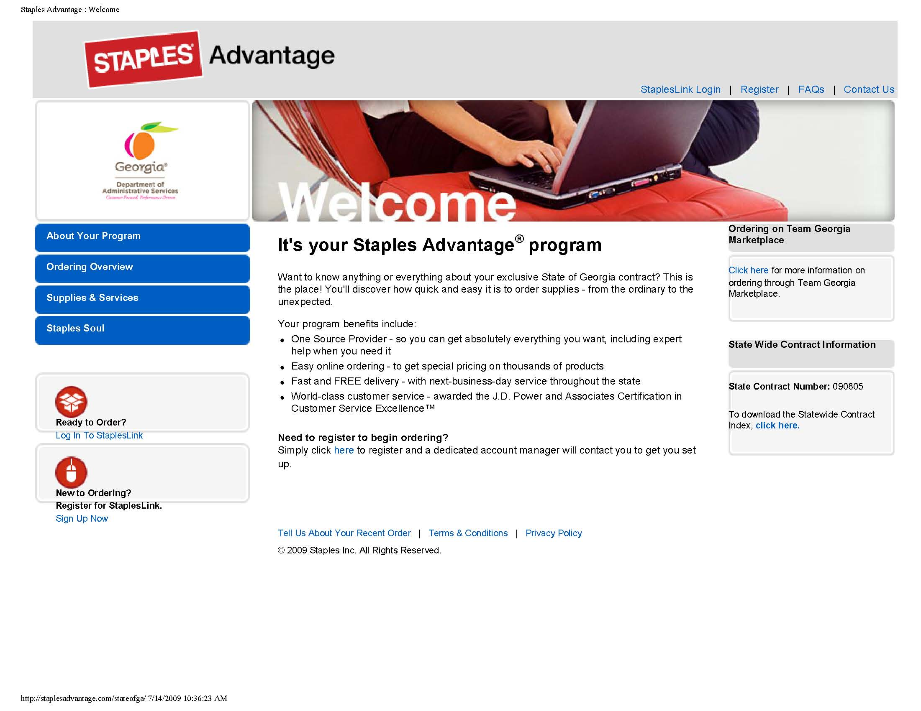

Slide 14
CUSTOMER ACCOUNT MANAGEMENT HIGHLIGHTS
Mr. Terone Harris and
Mr. Andrew Brasselton
OfficeMax, Inc.
Notes:
Thank you very much Lamar. I would like to now introduce Mr. Terone Harris and Mr. Andy Brasselton, who are here representing a new statewide supplier, OFFICEMAX, our awarded supplier for General Office Supplies,

Slide 15
For More Information
If you have questions about this Statewide Contract:
Submit Questions to:
Vendor Contact Information:
Email Address: carl.hall@doas.ga.gov
Person to Contact:
Dr. Carl A. Hall, Ph.D, JD, C.P.M.
Phone Number:
404-657-4254
STAPLES
Email Address: Lamar Huff@staples.com
Person to Contact:
Mr. Lamar Huff
OFFICEMAX
Email Address: Teroneharrisjr@officemax.com
Person to Contact:
Mr. Terone Harris

Slide 16
Questions?
?

